Slide 1
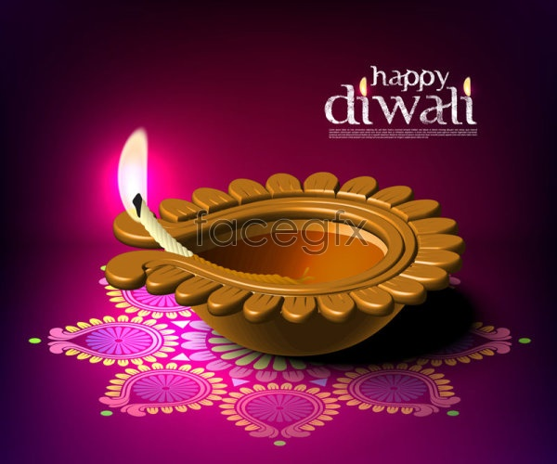
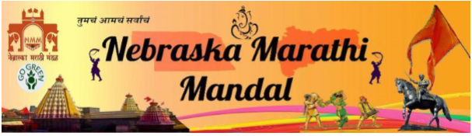
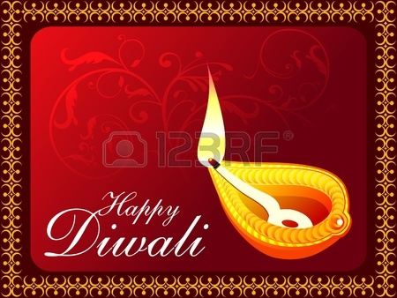
Nebraska Marathi Mandal welcomes you to celebrate - Diwali ( (Deepavali)

Slide 2
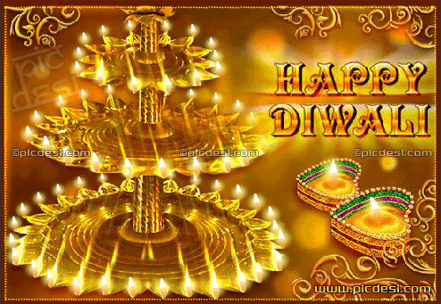
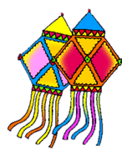
What is Deepavali?
Diwali derived from the Sanskrit word “Deepavali”
Deepavali = Deep + Avali
Deep = Light
Avali = A row
Diwali = Deepavali = Row of Lights

Slide 3
When ?
The Indian calendar is based on the lunar cycle and the movement of the moon, unlike the conventional Gregorian/English calendar.
The result is that Indian festivals move sideways the English calendar from year to year.
Diwali, for example falls on the date of the no moon In the month of Kartika (Hindi Calendar), usually this is in October or November.

Slide 4
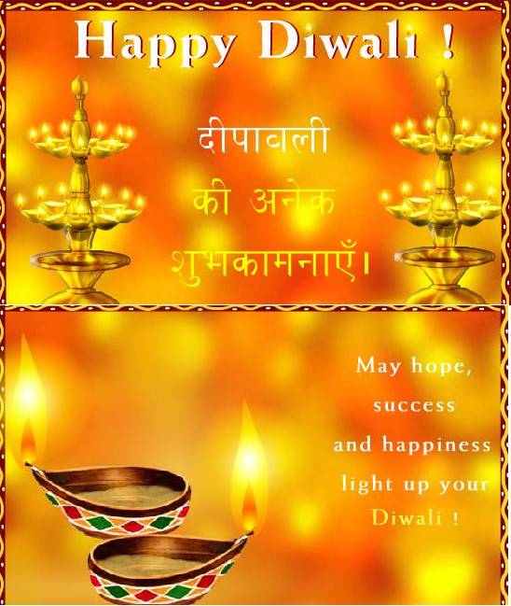
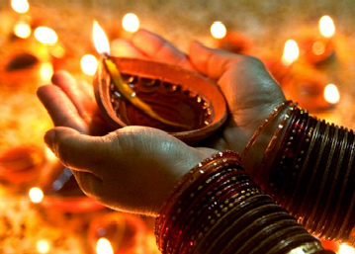
DEEPAVALI
One of the most common festival of India
Triumph of good over evil
Remove darkness and ignorance
Bring in light and knowledge
Stories Behind the Celebration
Five Day Celebration
Rangoli
Fireworks
Family Get Together
New Colorful clothes
Distributing Sweets

Slide 5
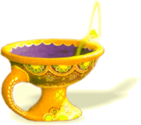
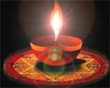
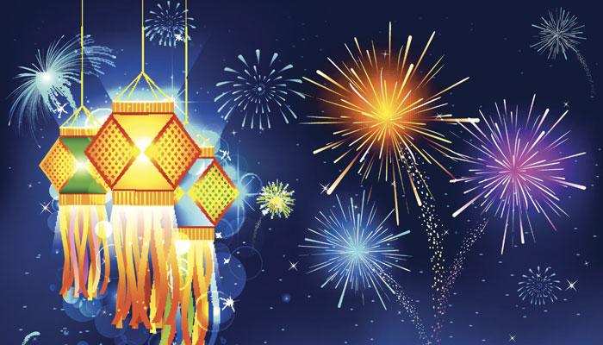
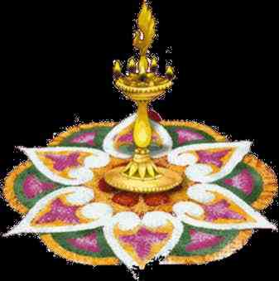
Significance of Lamp
Light symbolizes knowledge
Light is Lord Himself
Light removes darkness that symbolizes ignorance

Slide 6
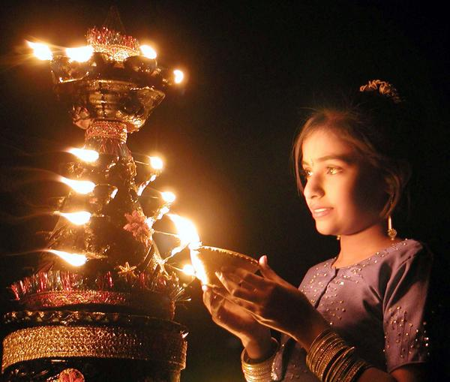
Significance of Light
Deepavali is a people oriented festival when enmities are forgotten and families and friends meet to enjoy and establish a world of closeness. As the light from within shines through, the ignorance that blinds us fades away!

Slide 7
How is it celebrated?
It is celebrated for 5 days.
People light their houses with lots of little oil lamps
Oil lamp symbolizes our negative tendencies
Wick symbolizes our ego
Lighting of the lamp signifies, Burning of our ego.
Flame in the lamp burns upwards. This signifies
Acquire knowledge so as to take us towards higher ideals
Special worships are done at home and temples

Slide 8
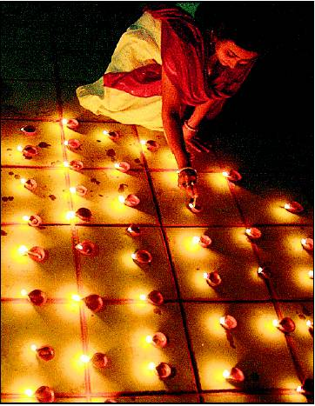
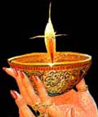
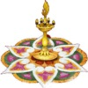
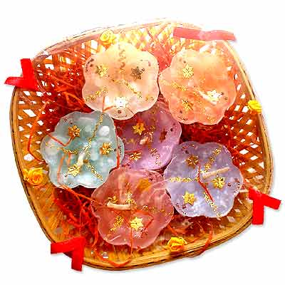

Celebrations
Homes are thoroughly cleaned,
windows are opened and diyas are lit
as a greeting to Laxmi, the goddess of wealth.
Candles are often substituted for diyas.
Gifts are exchanged and festive
meals are prepared.

Slide 9
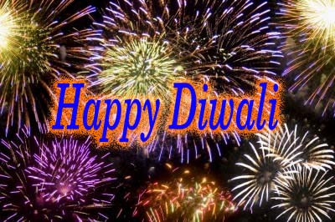
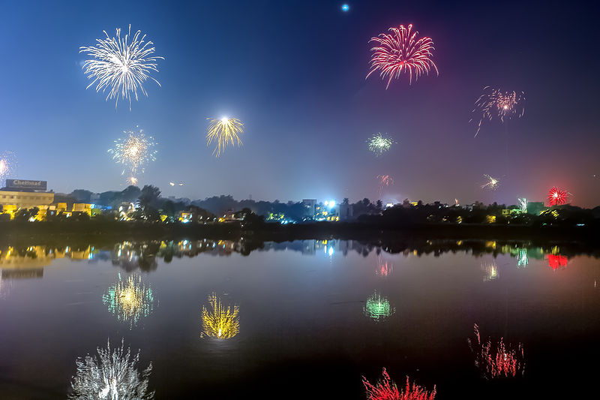
Celebrations…
After sunset, fireworks are seen everywhere…each and every street…

Slide 10
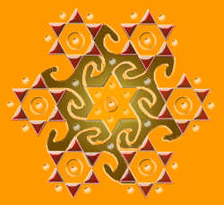
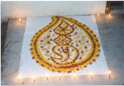
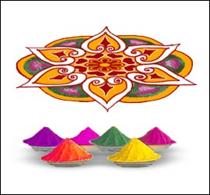
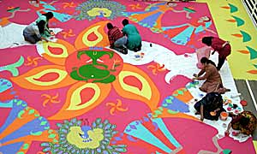
Celebrations…
Beautiful and colorful designs are put in front of the houses called “Rangoli”

Slide 11
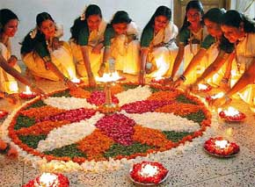
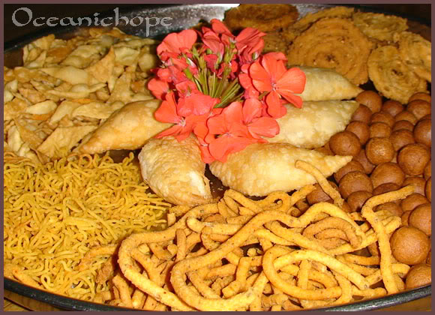
Family Get-togethers
Special occasion to come together
Celebrate together
Special dishes and sweets are prepared
Eat together with families and friends

Slide 12
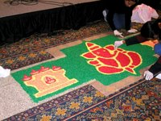
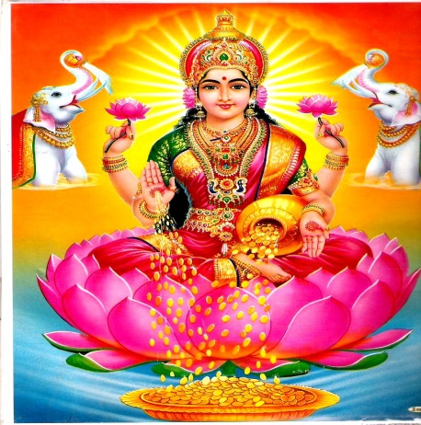
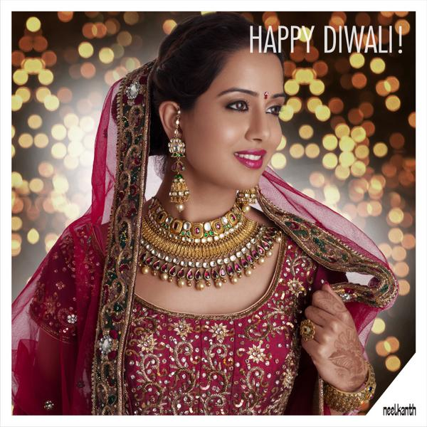
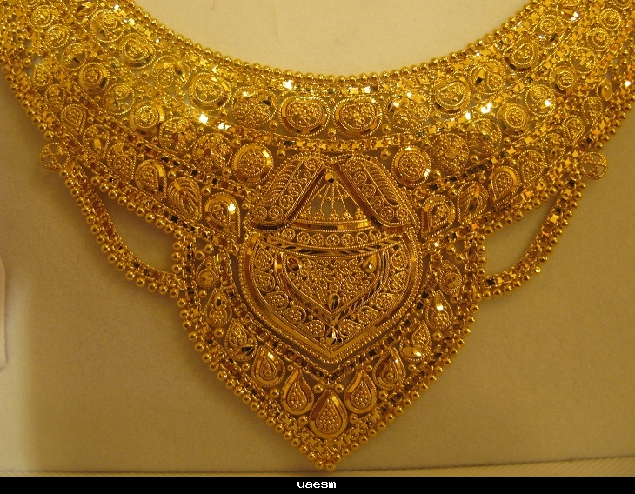
FIVE DAYS OF FESTIVITIES
The first day is called “Dhana Teras”. People buy jewellery and
worship God.

Slide 13
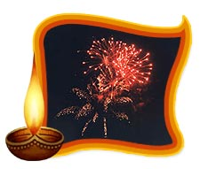
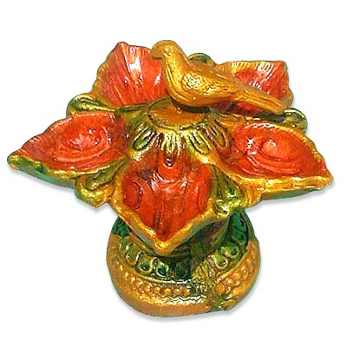
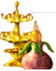
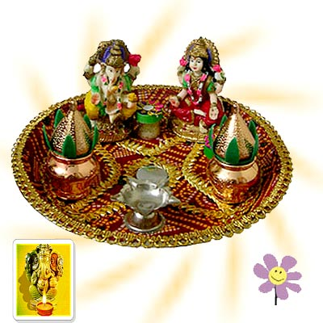
Second day
“Naraka Chaturdashi”
marks the death of the
tyrant king “Narakusara” who
imprisoned thousands of princesses.

Slide 14
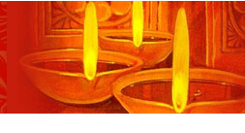
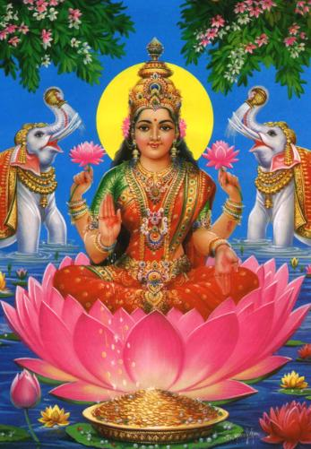
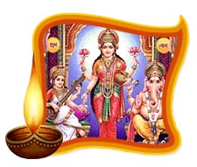
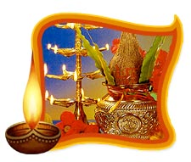
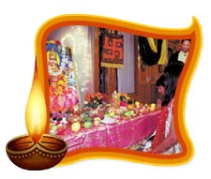
Third day
The most important day
called “Lakshmi-Pujan”
Goddess Lakshmi,
the goddess of good luck,
wealth and fortune
is worshiped
Those who have a business
do the Puja in offices as
it is considered lucky
and auspicious.

Slide 15
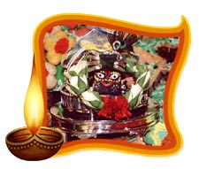
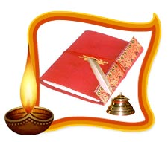
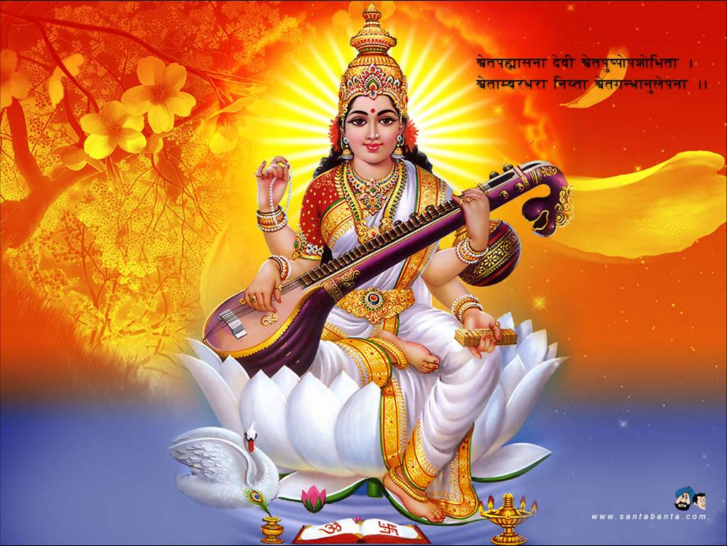
Fourth day
“PADWA / VARSHAPRATIPADA”
Coronation of King Vikramaditya
Vikaram-Calendar started from this day

Slide 16
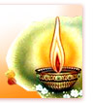
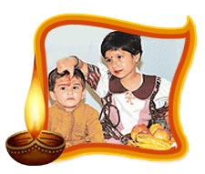
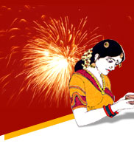
Fifth day
“Bhau Beej/Bhaiya Dooj”
Sister puts a sacred mark
on her brother's forehead
and prays for his long life
and prosperity
Brothers give their sisters
presents in return.

Slide 17
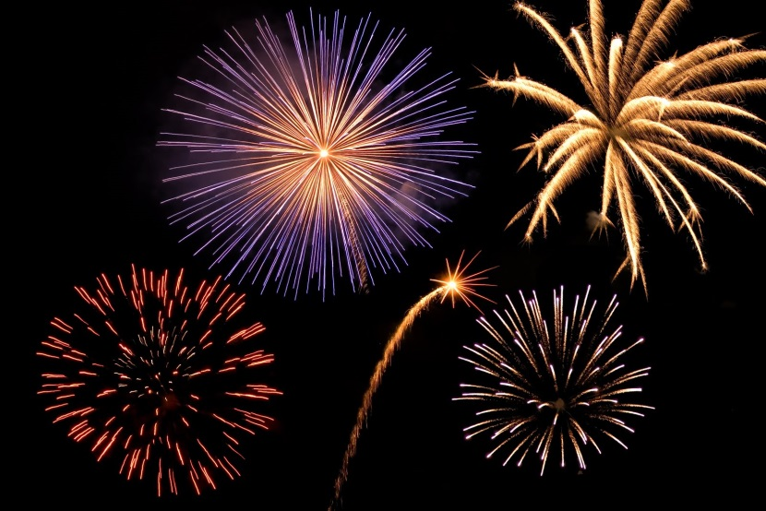
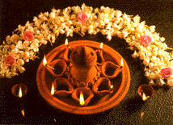
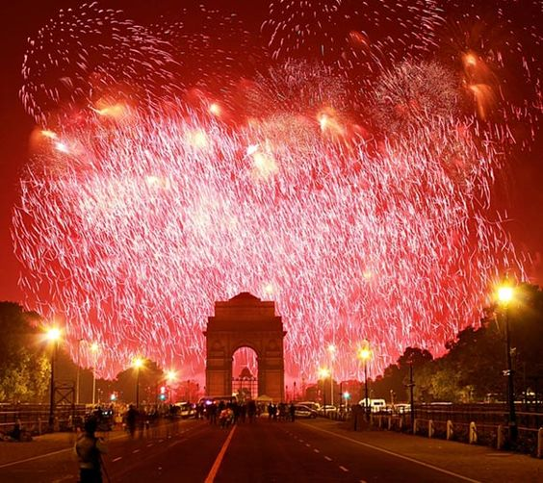
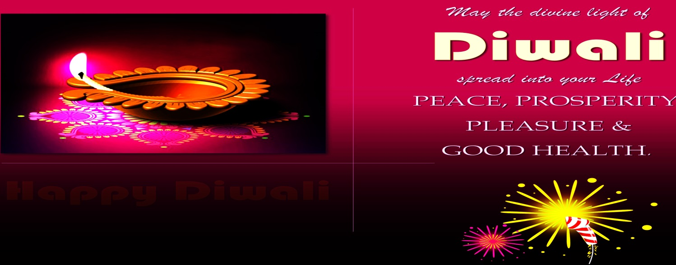
Lights-Lamps and Fireworks

Slide 18
Story of King Rama
After fourteen years of exile in the forest, the Prince of Ayodhya, Rama, and his brother Laksman, returned to their hometown.
Before that, they defeated Ravana in a fierce war. Ravana had kidnapped Rama’s wife, Sita.
Upon Rama's return to Ayodhya the people of the town lit lamps to welcome the Prince back and to celebrate the victory over demon Ravana.
Overjoyed at Queen Sita's rescue and the safe return of King Rama, the people danced and celebrated and fired fireworks to show how happy they were. These festivities continue every year at Diwali and are still celebrated today.

Slide 19
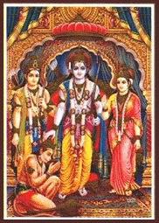
The Coronation of Prince Rama
After defeating Ravana and returning to his hometown, Rama was then the king after coronation.

Slide 20
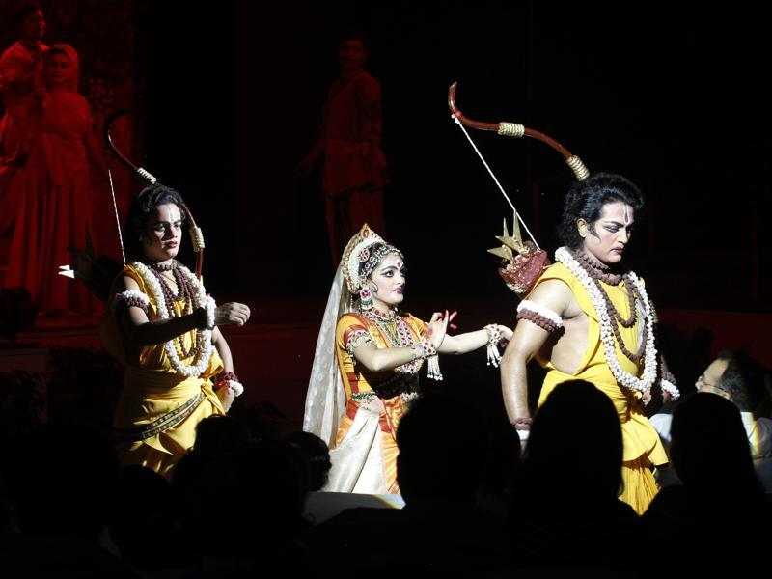
RAMLILA (Traditional Indian Performance of Ramayana)

Slide 21
RAngoli Patterns

Slide 22
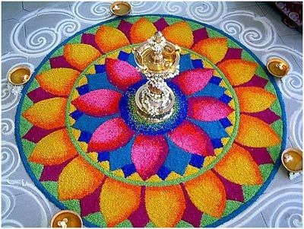
“Rangoli” is a colorful design drawn on the floor near the entrance to a house to welcome guests.

Slide 23

During Diwali, people draw bright Rangoli patterns on the floor by the front door to encourage the goddess Lakshmi to enter their homes.

Slide 24

Rangoli can be square, rectangular or circular.

Slide 25

Traditionally drawn using rice grains, flour, sand or chalk.

Slide 26





Rangoli come in all shapes and sizes!

Slide 27


Happy Diwali

Slide 28




